Slide 1
Cybersecurity
Addis Ababa Institute Of Technology
Engineering Profession
Assignment
By: Amanuel Legesse
ID: ATE/3628/11
Submitted To: Mr.Betsegaw Lemma
Feb,2020

Slide 2
Cybersecurity Resposibilies
 | Planning, implementing, managing, monitoring and upgrading security
 | Troubleshooting security and network problems.
 | Testing and identifying network and system vulnerabilities
 | Daily administrative tasks, reporting and communication with the relevant departments in the organization..

Slide 3





Cybersecurity Programming SKills
Python
C++
Java
Node
GO
Advanced
Basic
Proffesient
Basic
Advanced

Slide 4

Cybersecurity Qualification
To ensure success, a Cyber Security Engineer must display an excellent understanding of technology infrastructures using
Web-
Proxy
Fire-
wall
Problem
Solving
Data Loss
Prevention

Slide 5


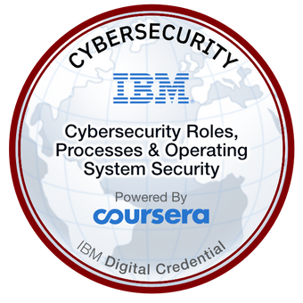
Cybersecurity Certificates
Provide IT
professionals
with in-demand skills
Google’s hands-on, practice-based assessments
Experience with incident response and forensics
A degree in Computer Science, IT, Systems Engineering

Slide 6
Conclusion
This assignment helped me understand
1
The Skiils, Resposibilites and qualification needed
2
Programming languages that have to learned and have level of experience
Certificates needed to enroll in a cyber security job or any other job for that matter
3

Slide 7




Reference

